Slide 1

GARAGE MANAGEMENT SYSTEM
ADITHYA DAS M P
MES24MCA-2002
Department of Computer Applications
MES College of Engineering, Kuttippuram
20/08/2025

Slide 2
PRODUCT OWNER MR.HYDERALI K HOD DEPARTMENT OF COMPUTER APPLICATIONS MES COLLEGE OF ENGINEERING, KUTTIPPURAM

Slide 3
TABLE OF CONTENTS
Introduction
Objective
Existing System
Proposed System
Motivation
Functionalities
Module Description
Developing Environment
Sprint Backlog
Product Backlog
User Story
Project Plans
Data Flow Diagrams
ER Diagram

Slide 4
GARAGE MANAGEMENT SYSTEM
The Garage Management System is a web-based application designed to streamline all activities within a garage, offering role-based access for users such as Managers, Supervisors, Mechanics and Customers.
It aims to solve common issues in traditional garages, such as poor data storage, lack of worker coordination, and inefficient service tracking, by providing a centralized and systematic platform.

Slide 5
GARAGE MANAGEMENT SYSTEM
Features:
User login & authentication
Spare parts inventory management
Service tracking
Mechanic work hours
Appointment booking
Job assignment
Sales tracking

Slide 6
OBJECTIVES
To automate and streamline garage operations using a centralized web-based system.
To reduce manual errors and paperwork by digitizing service records and inventory.
To allow customers to book services online and track the status of their vehicles.
To provide role-based access for admin, manager, supervisor, mechanic and customer.

Slide 7
OBJECTIVES
To improve service through better task allocation and tracking of mechanic work hours.
To manage spare part inventory efficiently and track sales.
To enable secure and transparent payment processing for completed services.

Slide 8
EXISTING SYSTEM
Manual data entry makes operations slow and time-consuming.
High dependency on manpower for basic tasks.
Lack of proper service history and maintenance tracking.
Inaccurate and slow inventory management.
Delays in service due to poor communication and coordination.
No real-time updates or notifications for customers.
High risk of data loss or manipulation due to lack of security.Low overall efficiency with increased chances of errors.

Slide 9
PROPOSED SYSTEM
Real-time inventory management for spare parts, reducing shortages and excess stock.
Reduced manpower and operational costs through digital automation.
Enhanced customer service with online updates, payment options, and notifications.
Role-based access control ensuring secure and accountable operations.
Faster and more accurate data entry via form-based input, minimizing errors.
High security with restricted data access only for authorized users.
Increased efficiency and reliability of garage operations through centralized data storage.

Slide 10
MOTIVATIONS
To centralize and automate all garage operations for better efficiency.
To reduce manual errors in booking, inventory, and billing processes.
To improve customer satisfaction with faster service and transparency.
To provide accurate reports and insights for better decision-making.

Slide 11
FUNCTIONALITIES
User Login and Authentication-Enables secure access for all user roles by validating credentials and assigning role-based access.
Spare Parts Inventory Management-Allows admin or supervisor to manage spare part stock by validating and updating stock records in the database.
Vehicle Service Appointment Booking-Lets customers book service slots by checking availability and saving the appointment details.

Slide 12
FUNCTIONALITIES
Job Assignment to Mechanics-Assigns repair tasks to mechanics based on their specialization and updates the job status in the system.
Billing and Payment Handling-Issues service bills and manages payment details by calculating the bill and storing payment information.
Reports and Analytics-Generates insights on garage operations by fetching and analyzing stored data.

Slide 13
MODULE DESCRIPTION
Manager Module:
. Generate bills for customer appointments.
. Manage spare parts inventory.
. View and analyze reports.
. View/Update customer information.
2. Supervisor Module:
. Assign jobs to mechanics.
. View assigned jobs for monitoring.

Slide 14
MODULE DESCRIPTION
4. Customer Module:
. Book service appointments.
. View vehicle service status.
. Pay bills online.
. Login & Authentication
4. Mechanic Module:
. View jobs assigned by supervisor.
. Update status of ongoing jobs.
. Request spare parts for repairs

Slide 15
DEVELOPING ENVIRONMENT
Operating System: Windows 11 / Ubuntu Linux
Frontend: HTML,CSS,JAVASCRIPT
Backend: PHP
Database: MySQL
Web Browser :Google Chrome/Firefox
IDEs: Visual Studio Code
Version Control: GitHub (optional for code management)

Slide 16
SPRINT BACKLOG
Backlog tem |  | Status And Completion Date | Original Estimation in Hours | Day 1 hrs | Day 2 hrs | Day 3 hrs | Day 4 hrs | Day 5 hrs | Day 6 hrs | Day 7 hrs | Day 8 hrs | Day 9 hrs | Day 10 hrs
SPRINT1
User Registration/Login (All Roles) | 10/08/2025 | 10/08/202 | 8 | 2 | 2 | 2 | 2 | 0 | 0 | 0 | 0 | 0 | 0
Service Booking & Scheduling | 15/08/2025 | 15/08/2025 | 4 | 1 | 1 | 1 | 1 | 2 | 3 | 3 | 2 | 2 | 0
SPRINT 2
Vehicle Status Tracking (Customer) | 01/09/2025 | 01/09/2025 | 10 | 2 | 2 | 2 | 2 | 2 | 0 | 0 | 0 | 0 | 0
Job Assignment (Supervisor to Mechanic) | 06/09/2025 | 30/08/2025 | 8 | 0 | 0 | 0 | 0 | 0 | 2 | 2 | 2 | 2 | 0

Slide 17
SPRINT BACKLOG
Mechanic work hours tracking | 10/09/2025 | 7 | 0 | 0 | 0 | 0 | 0 | 0 | 0 | 0 | 0 | 2
Service History & Notifications | 10/09/2025 | 7 | 0 | 0 | 0 | 0 | 0 | 0 | 0 | 0 | 0 | 1
SPRINT 3
Inventory Management(Parts Tracking) | 22/09/2025 | 15 | 2 | 2 | 2 | 2 | 2 | 2 | 2 | 1 | 0 | 0
Report Generation | 03/10/2025 | 9 | 0 | 0 | 0 | 0 | 0 | 0 | 0 | 0 | 0 | 0
Payment Processing Integration | 28/09/2025 | 10 | 0 | 0 | 0 | 0 | 0 | 0 | 0 | 0 | 2 | 2
TOTAL |  | 86 | 6 | 6 | 6 | 6 | 5 | 7 | 7 | 5 | 6 | 5

Slide 18
PRODUCT BACKLOG
ID | NAME | PRIORITY | ESTIMATE | STATUS
1 | User Registration / Login | High | 8 | COMPLETED
2 | Service Booking & Scheduling | High | 12 | COMPLETED
3 | Vehicle Status Tracking | High | 10 | COMPLETED
4 | Job Assignment(Supervisor to Mechanic) | High | 8 | COMPLETED
5 | Inventory Management | Medium | 8 | COMPLETED

Slide 19
PRODUCT BACKLOG
6 | Machine Work Hour Tracking | Medium | 7 | COMPLETED
7 | Payment Processing Integration | High | 10 | COMPLETED
8 | Report Generation(Manager) | Medium | 9 | COMPLETED
9 | Service History & Notifications(Customer) | Medium | 16 | COMPLETED

Slide 20
USER STORY
User Story ID | As a type of User | I want to | So that i can
1 | User | Register | Create an account and access garage services.
1 | User | Login | Securely access my account with correct credentials
1 | User | Book Vehicle Services | Schedule my vehicle service online.
1 | User | Track my vehicle's service status. | Monitor the progress of repairs in real-time.
1 | User | Receive notifications for upcoming maintenance | Stay informed about scheduled services and vehicle health.

Slide 21
USER STORY
User Story ID | As a type of User | I want to | So that i can
1 | User | Make payments for services | Settle bills securely and efficiently.
1 | User | View my service history | Keep track of past maintenance and repairs for my vehicle.
2 | Mechanic | View assigned jobs | Understand my daily tasks and priorities
2 | Mechanic | Request spare parts for a job | Ensure I have the necessary components to complete repairs.

Slide 22
USER STORY
User Story ID | As a type of User | I want to | So that i can
2 | Mechanic | Update the status of a job | Inform supervisors and customers about progress.
2 | Mechanic | Log my working hours | Accurately record my time spent on tasks.
3 | Supervisor | Track inventory of spare parts | Ensure parts are available and manage stock levels.
3 | Supervisor | Monitor the progress of ongoing services | Ensure timely completion and identify bottlenecks

Slide 23
USER STORY
User Story ID | As a type of User | I want to | So that i can
3 | Supervisor | Generate service schedules | Plan and organize future maintenance and repair tasks.
3 | Supervisor | Assign jobs to mechanics | Distribute workload efficiently among the team.
3 | Supervisor | Monitor mechanic work hours | Track team performance and manage labor costs.
4 | Manager | View and update customer information | Maintain accurate customer records and service history.

Slide 24
USER STORY
User Story ID | As a type of User | I want to | So that i can
4 | Manager | Manage spare parts inventory | Add new stock, update quantities, and oversee parts sales.
4 | Manager | Create and manage bills for services | Ensure accurate financial tracking and customer invoicing.
4 | Manager | Generate reports on garage performance | Gain insights into service completion, revenue, and parts usage.

Slide 25
PROJECT PLAN
User StoryID | Task Name | Start Date | End Date | Days | Status
1 | Sprint 1 | 06/08/2025 | 15/08/2025 | 20 | Completed
 |  |  |  |  | Completed
1 |  | 11/08/2025 | 15/08/2025
 |  |  |  |  | Completed
1 | Sprint 2 | 26/08/2025 | 01/09/2025 | 32 | Completed
3 |  | 02/09/2025 | 06/09/2025 |  | Completed
3 |  | 07/09/2025 | 10/09/2025 |  | Completed
5 |  | 06/09/2025 | 15/09/2025 |  | Completed

Slide 26
PROJECT PLAN
3 | SPRINT 3 | 15/09/2025 | 22/09/2025 | 34 | Completed
1 |  | 23/09/2025 | 28/09/2025 |  | Completed
4 |  | 29/09/2025 | 03/10/2025 |  | Completed

Slide 27
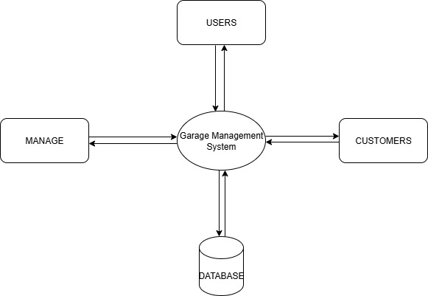
DATA FLOW DIAGRAM
LEVEL 0

Slide 28
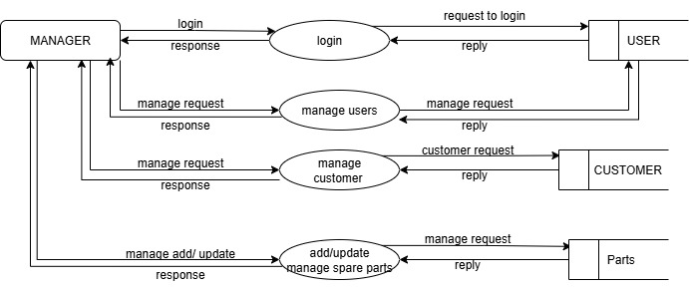
DATA FLOW DIAGRAM
Level 1

Slide 29
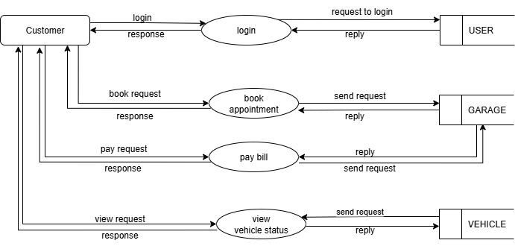
DATA FLOW DIAGRAM
Level 2

Slide 30
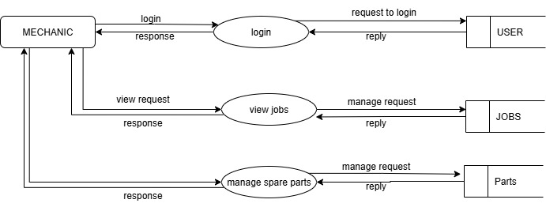
DATA FLOW DIAGRAM
Level 3

Slide 31
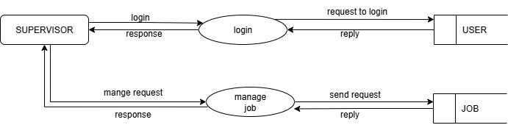
DATA FLOW DIAGRAM
Level 4

Slide 32
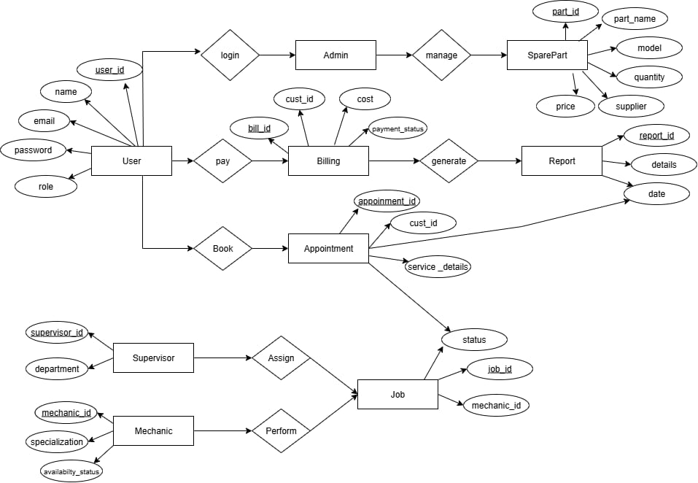
ER DIAGRAM

Slide 33
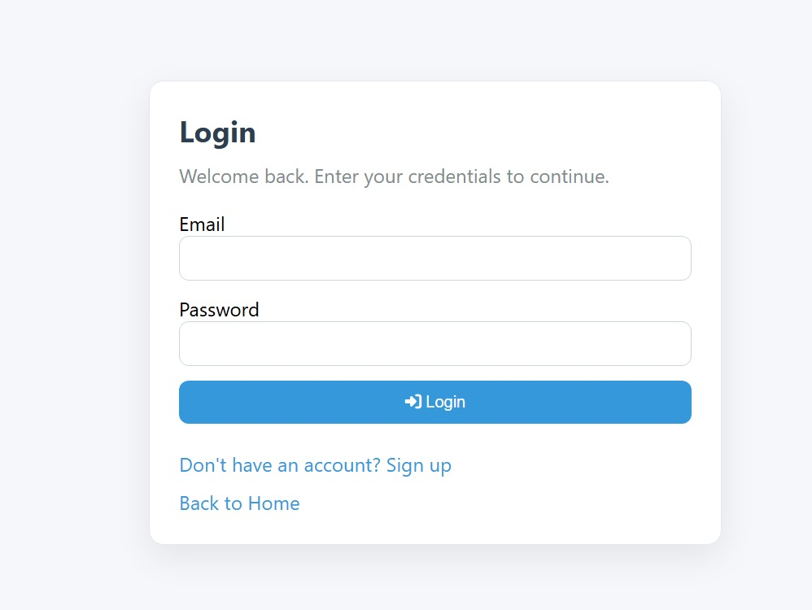
FUNCTIONALITY 1

Slide 34
PROGRAM CODE
<body>
<div class="card">
<h2 class="h">Login</h2>
<p class="p">Welcome back. Enter your credentials to continue.</p>
<?php if (!empty($success)): ?>
<div class="alert alert-success"><?= htmlspecialchars($success) ?></div>
<?php endif; ?>
<?php foreach ($errors as $e): ?>
<div class="alert alert-danger"><?= htmlspecialchars($e) ?></div>
<?php endforeach; ?>
<form method="post" action="">
<input type="hidden" name="_token" value="<?= htmlspecialchars(csrf_token()) ?>">
<div class="form-row">
<label>Email</label>
<input class="input" type="email" name="email" required>
</div>
<div class="form-row">
<label>Password</label>
<input class="input" type="password" name="password" required>
</div>
<div class="form-row">
<button class="btn" type="submit"><i class="fa fa-sign-in-alt"></i> Login</button>
</div>
</form>
<a class="link" href="signup.php">Don't have an account? Sign up</a>
<br>
<a class="link" href="index.php">Back to Home</a>
</div>
</body>
</html>

Slide 35
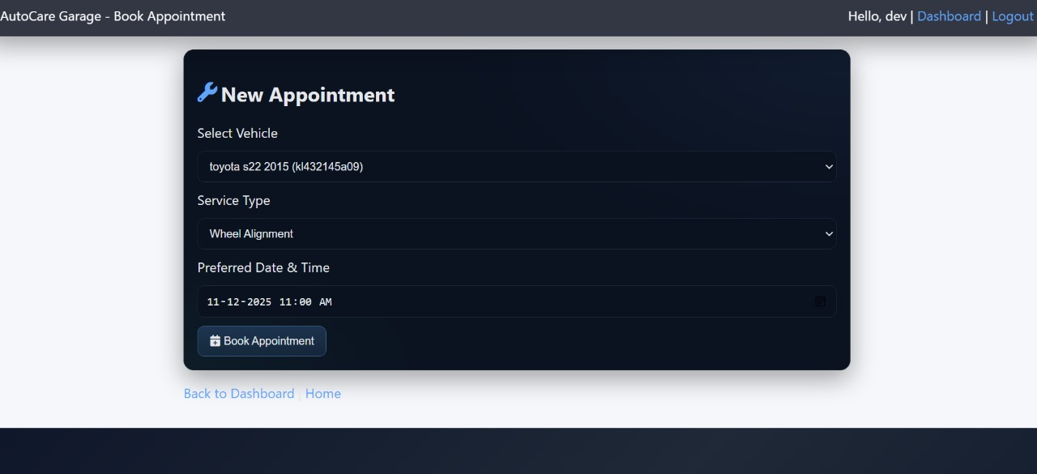
FUNCTIONALITY 2

Slide 36
PROGRAM CODE
<div class="container">
<div class="card">
<h2>New Appointment</h2>
<?php foreach ($errors as $e): ?>
<div class="alert alert-danger"><?= htmlspecialchars($e) ?></div>
<?php endforeach; ?>
<?php if (!$vehicles): ?>
<div class="notice">You need to add a vehicle before booking an appointment. Go to <a class="link" href="vehicles.php">My Vehicles</a>.</div>
<?php endif; ?>
<?php if (!$services): ?>
<div class="notice">No service types are configured yet. Please add entries into the <code>service_types</code> table (e.g., Oil Change, Brake Repair) via phpMyAdmin.</div>
<?php endif; ?>
<form method="post">
<input type="hidden" name="_token" value="<?= htmlspecialchars(csrf_token()) ?>">
<div class="form-row">
<label style="flex-basis:100%">Select Vehicle</label>
<select class="select" name="vehicle_id" required <?= !$vehicles?'disabled':'' ?>>
<option value="">-- Choose Vehicle --</option>
<?php foreach ($vehicles as $v): ?>
<option value="<?= (int)$v['id'] ?>"><?= htmlspecialchars($v['make'].' '.$v['model'].' '.$v['year'].' '.($v['license_plate']?('('.$v['license_plate'].')'):'') ) ?></option>
<?php endforeach; ?>
</select>
</div>
<div class="form-row">
<label style="flex-basis:100%">Service Type</label>
</div>
<div class="form-row">
<label style="flex-basis:100%">Preferred Date & Time</label>
</div>
<button class="btn" type="submit" <?= (!$vehicles||!$services)?'disabled':'' ?>><i class="fa fa-calendar-plus"></i> Book Appointment</button>
</form>
</div>
<p><a class="link" href="dashboard.php">Back to Dashboard</a> | <a class="link" href="../index.php">Home</a></p>
</div>
</body>
</html>

Slide 37
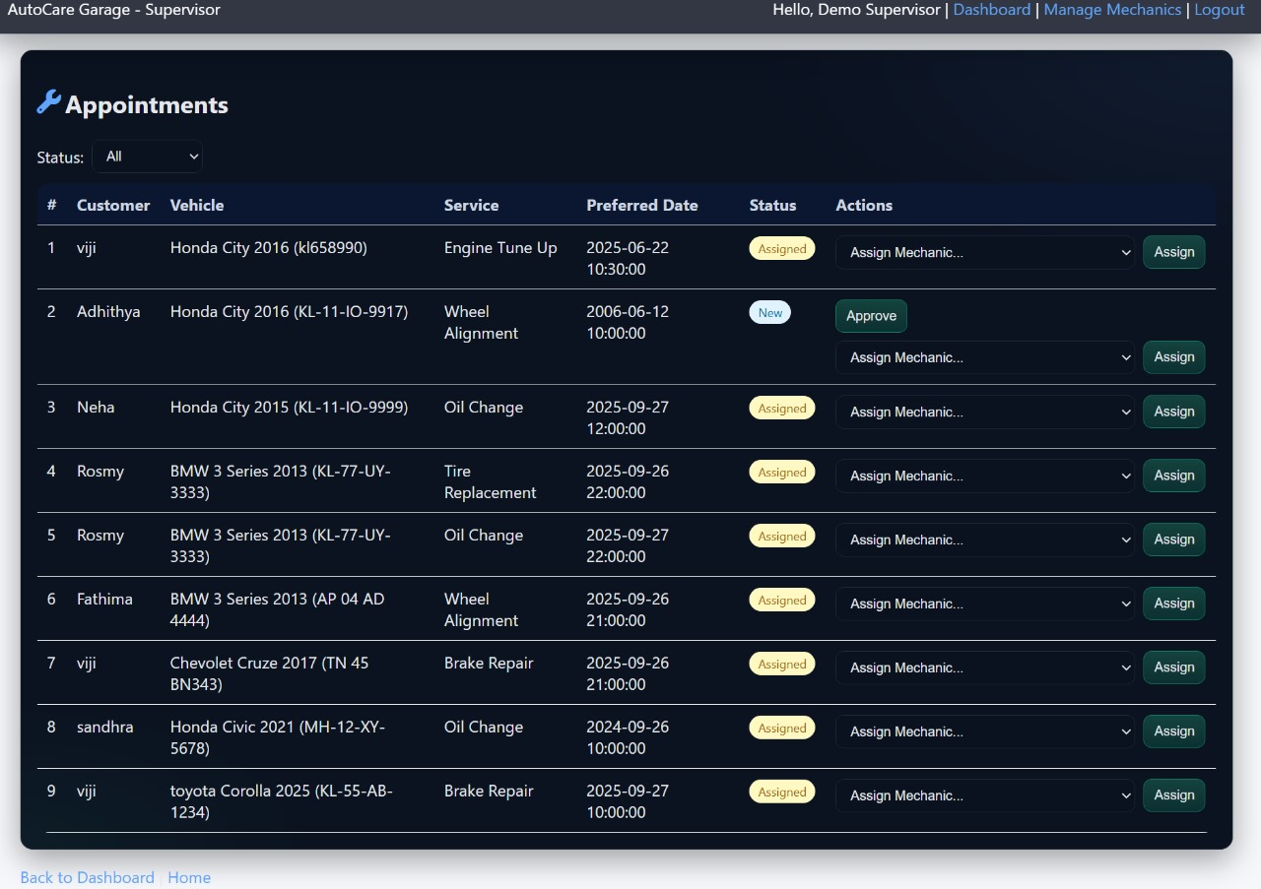
FUNCTIONALITY 3

Slide 38
PROGRAM CODE
<?php if ($appointments): $i=1; foreach ($appointments as $a): ?>
<tr>
<td><?= $i++ ?></td>
<td><?= htmlspecialchars($a['customer_name'] ?: ('Customer#'.$a['customer_id'])) ?></td>
<td><?= htmlspecialchars($a['make'].' '.$a['model'].' '.$a['year'].' '.($a['license_plate']?('('.$a['license_plate'].')'):'') ) ?></td>
<td><?= htmlspecialchars($a['service_name']) ?></td>
<td><?= htmlspecialchars($a['preferred_date']) ?></td>
<td><span class="badge <?= str_replace('-','_', $a['status']) ?>"><?= htmlspecialchars(ucwords(str_replace('_',' ', $a['status']))) ?></span></td>
<td>
<div style="display:flex;gap:8px;flex-direction:column;">
<?php if ($a['status'] === 'new'): ?>
<form method="post" class="form-inline">
<input type="hidden" name="_token" value="<?= htmlspecialchars(csrf_token()) ?>">
<input type="hidden" name="action" value="approve">
<input type="hidden" name="appointment_id" value="<?= (int)$a['id'] ?>">
<button class="btn primary" type="submit">Approve</button>
</form>
<?php endif; ?>
<form method="post" class="form-inline">
<input type="hidden" name="_token" value="<?= htmlspecialchars(csrf_token()) ?>">
<select class="select" name="mechanic_id" required>
<option value="">Assign Mechanic...</option>
<?php foreach ($mechanics as $m): ?>
<option value="<?= (int)$m['id'] ?>"><?= htmlspecialchars($m['name'].' ('.$m['email'].')') ?></option>
<?php endforeach; ?>
</select>
<button class="btn primary" type="submit">Assign</button>
</form>
</div>
</tr>
<?php endforeach; else: ?>
<tr><td colspan="7">No appointments found.</td></tr>
<?php endif; ?>
</tbody>
</table>
</div>
<p><a class="link" href="dashboard.php">Back to Dashboard</a> | <a class="link" href="../index.php">Home</a></p>
</div>
</body>
</html>

Slide 39
THANK YOU

